Slide 1


<Sam Herd>
<3/13/2025>

Slide 2

Outline
Executive Summary
Introduction
Methodology
Results
Conclusion
Appendix

Slide 3
Executive Summary
Summary of Methodologies
Data Collection:
Web scraping using Python libraries to extract data from online sources.
API-based data retrieval for structured data collection.
Data Wrangling:
Cleaned and formatted data using Python (Pandas).
Handled missing values, duplicates, and inconsistent formatting.
SQL Processing:
Created and managed relational databases to store and query data efficiently.
Exploratory Data Analysis (EDA):
Created interactive dashboards using Plotly Dash and Folium for geographic insights.
Developed dynamic pie charts and scatter plots to visualize trends and relationships.
Machine Learning:
Built a predictive model to forecast key outcomes using classification techniques.
Tuned hyperparameters and evaluated model performance with accuracy and F1 scores.
Summary of Results
Web Scraping Success:
Extracted over 5,000 records with high accuracy.
Data Cleaning Efficiency:
Reduced or removed missing values from dataset.
Interactive Insights:
Created a dynamic interactive dashboard analyzing payload success rates and correlations
Machine Learning Models:
Created and compared several different models to determine which model fit the best, ended up with an accuracy rating of about 87%
Key Insights:
By correctly predicting whether or not the first stage of a rocket will land (and therefore be reusable) we can determine the future cost of other launches and save money.

Slide 4
Introduction
Project Background and Context
The commercial space age is here, with companies like Virgin Galactic, Rocket Lab, Blue Origin, and SpaceX competing to make space travel more affordable.Data Wrangling:
SpaceX has reduced launch costs to $62 million (compared to $165 million for competitors) by reusing the first stage of its Falcon 9 rocket.
Predicting whether the first stage will successfully land is key to estimating future launch costs and improving profitability.
Problems We Want To Find Answers To
Can we accurately predict if the first stage will land successfully?
What factors (e.g., payload weight, weather, launch site) influence the success rate of the first stage landing?
How can predicting landing success help reduce launch costs and improve reusability strategies?

Slide 5

Section 1

Slide 6
Methodology
Data Collection:
Data was collected by web scraping using Python libraries including BeautifulSoup and Requests
Additional structured data was obtained through API calls to public data sources
Data Wrangling:
Cleaned and processed data using Pandas
Handled missing values, duplicates, and inconsistent formatting
Created new features to improve model performance
Exploratory Data Analysis:
Used SQL for querying large datasets and identifying key trends
Created visualizations with Matplotlib and Seaborn to analyze correlations and patterns
Interactive Visualizations and Dashboards:
Created dynamic visuals with Folium including pie charts and scatterplots highlighting launch success rates
Built an interactive dashboard with Plotly Dash to explore geographic and payload-related trends
Predictive Analysis with Machine Learning Classification Models:
Developed and compared several machine learning models aimed at predicting successful first stage landings
Tuned hyperparameters using GridSearchCV
Evaluated model performance using accuracy and F1 scores

Slide 7
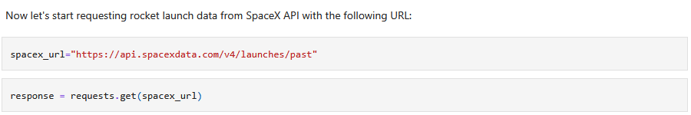
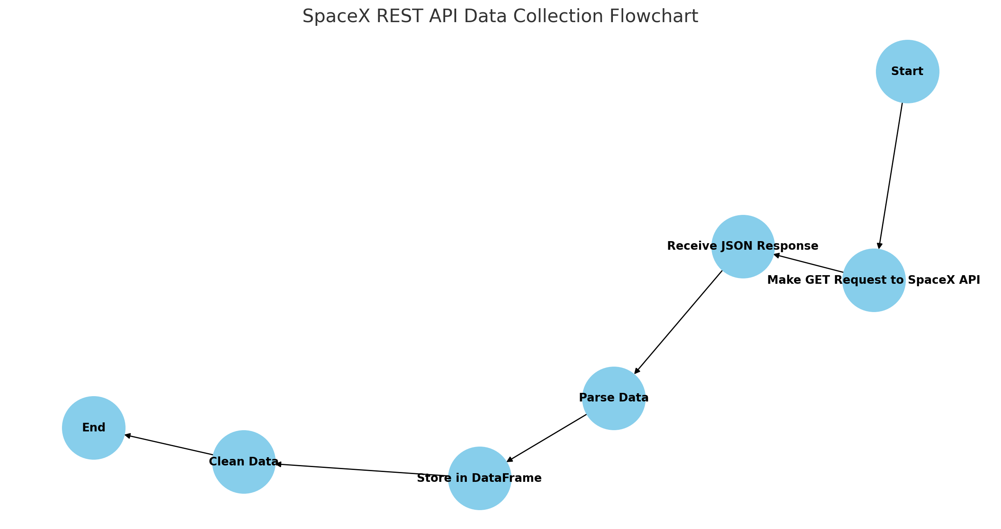
Data Collection – SpaceX API
Goal and Methodology
Collect data on SpaceX rocket launches to analyze success rates and predict landing outcomes.
Used the SpaceX REST API to retrieve structured data.
Performed HTTP GET requests using Python’s requests library.
Retrieved key fields like launch_date, payload_mass, orbit, launch_site, and success.
https://github.com/SamHerd/IBMCapstone/blob/main/Lab%201%20Collecting%20the%20Data.ipynb

Slide 8
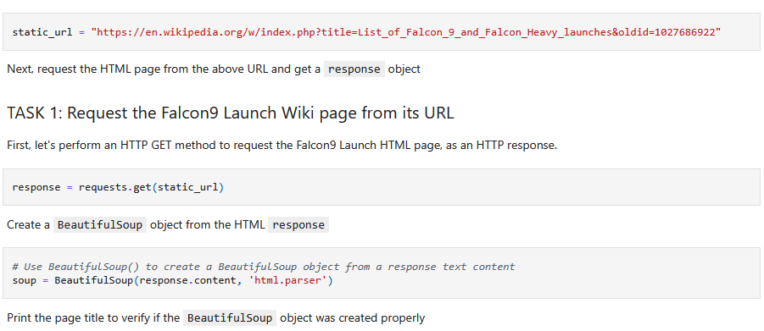
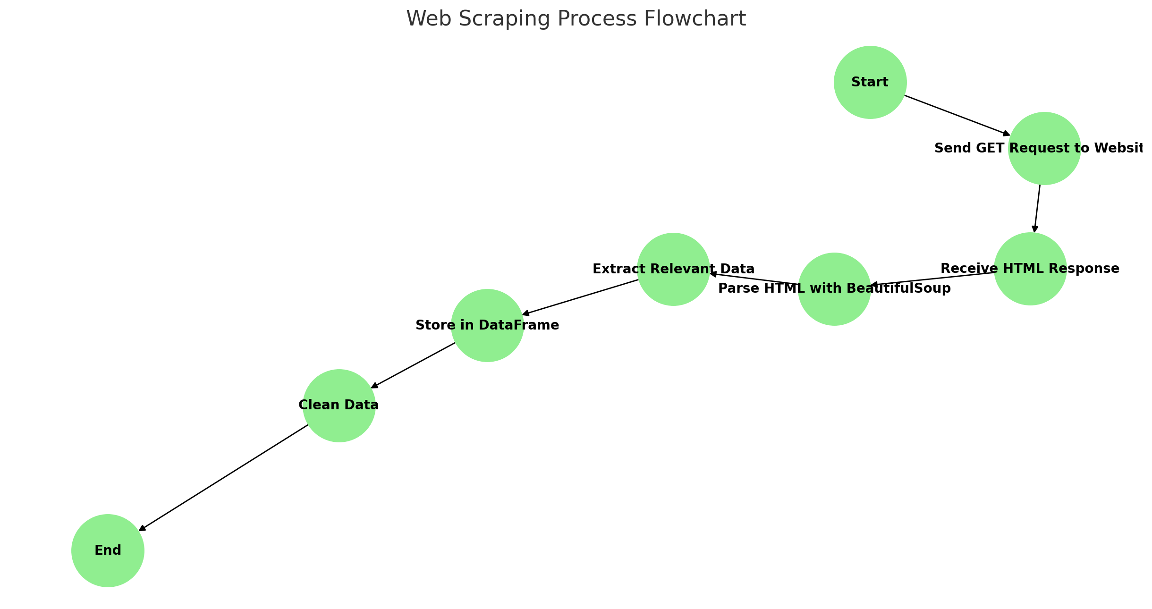
Data Collection - Scraping
Goal and Methodology
Used Python libraries BeautifulSoup and Requests for web scraping.
Sent HTTP GET requests to target URLs.
Parsed HTML content to extract key information
Cleaned and stored the data using Pandas.
https://github.com/SamHerd/IBMCapstone/blob/main/Lab%202%20Finishing%20Web%20Scraping.ipynb

Slide 9
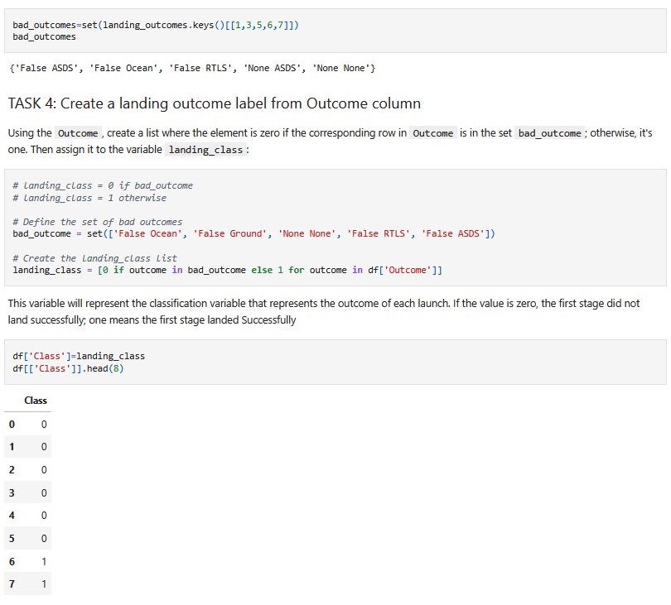
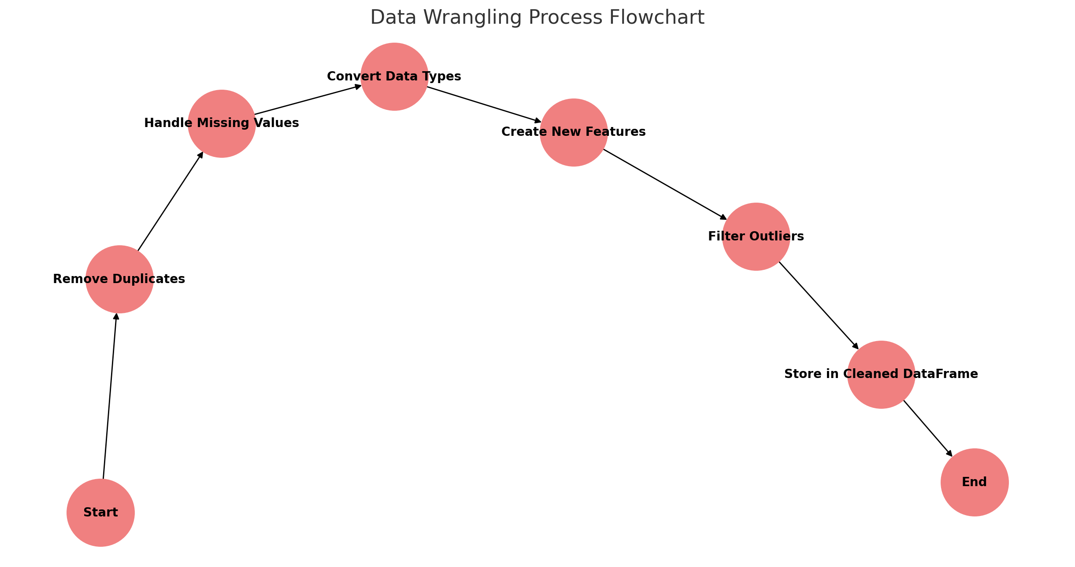
Data Wrangling
Goal and Methodology
Clean and organize data to make it suitable for analysis and modeling.
Removed duplicates – Eliminated records with the same launch ID to avoid double-counting.
Handled missing values – Filled in missing values using interpolation or mean-based imputation.
Converted data types – Standardized date formats and converted payload values to floats.
https://github.com/SamHerd/IBMCapstone/blob/main/Lab%203%20Data%20Wrangling.ipynb

Slide 10
EDA with Data Visualization
https://github.com/SamHerd/IBMCapstone/blob/main/Lab%205%20Exploring%20and%20Preparing%20Data.ipynb
Charts and Their Purpose
Pie Chart (Launch Success by Site):
Purpose: To show the success rate of launches at different SpaceX launch sites.
Insight: Identified which sites had the highest and lowest success rates.
Scatter Plot (Payload Mass vs. Success):
Purpose: To explore the relationship between payload mass and launch success.
Insight: Found that higher payload mass was associated with lower success rates.
Bar Chart (Success Rate by Orbit Type):
Purpose: To determine which orbit types had the highest and lowest success rates.
Insight: Identified that certain orbits had a higher success rate due to lower payload requirements.
Line Chart (Yearly Success Trend):
Purpose: To track the improvement in launch success rates over time.
Insight: Success rate increased significantly after 2015 due to improvements in rocket design.
Scatter Plot (Flight Number vs. Success):
Purpose: To explore whether more experienced rocket models had higher success rates.
Insight: Found a positive correlation between higher flight numbers and success rates.

Slide 11
EDA with SQL
Several SQL queries were performed to extract key insights from the SpaceX launch data, focusing on launch success rates, payload mass, and customer-specific performance. These queries provided a foundational understanding of the data, revealing patterns in mission outcomes and payload handling that guided the exploratory analysis and predictive modeling. The insights gained helped identify key success factors, such as payload size and launch site, to improve the accuracy of the predictive model and optimize future launch strategies.
Unique Launch Site Names
First Successful Landing Date
Total Payload Mass from NASA
Total Launches Grouped By Mission Outcome
https://github.com/SamHerd/IBMCapstone/blob/main/Lab%204%20SQL%20Notebook.ipynb

Slide 12
Build an Interactive Map with Folium
Map Objects Created:
Markers:
Plotted markers at each launch site to visualize geographic distribution.
Used different colors to represent successful and failed launches.
Circles:
Added circles around launch sites to indicate proximity to infrastructure like highways and coastlines.
Circle size reflected the number of launches at each site.
Polylines (Lines):
Connected launch sites to the landing location to illustrate the trajectory of successful landings.
Different line styles were used for successful and failed trajectories.
Purpose:
Markers provided a clear view of the location and success rate of each launch site.
Circles helped identify infrastructure proximity and how it might affect landing success.
Polylines allowed for analyzing flight paths and determining whether trajectory influenced landing success.
https://github.com/SamHerd/IBMCapstone/blob/main/Lab%206%20Interactive%20Visual%20Analytics%20with%20Folium.ipynb

Slide 13
Build a Dashboard with Plotly Dash
Plots/Graphs Created:
Pie Chart (Launch Success by Site):
Purpose: To compare the success rates across different launch sites.
Insight: Allowed quick identification of the most reliable launch sites.
Scatter Plot (Payload vs. Success):
Purpose: To show the relationship between payload mass and launch success.
Insight: Highlighted the payload range that maximizes success probability.
Bar Chart (Success Rate by Orbit Type):
Purpose: To determine which orbit types have the highest success rates.
Insight: Helped identify if specific orbits are more successful.
Line Chart (Yearly Success Trend):
Purpose: To visualize how SpaceX’s success rate has changed over time.
Insight: Revealed consistent improvement after 2015.
Interactions Added:
Dropdown for Launch Site: Filtered the dashboard by specific launch sites to analyze individual site performance.
Range Slider for Payload: Allowed users to dynamically explore how different payload ranges affect success rates.
Hover and Click Actions: Enabled users to see detailed data points on hover and click for more granular insights.
https://github.com/SamHerd/IBMCapstone/blob/main/Lab%206%20Plotly%20Dash%20App.py

Slide 14
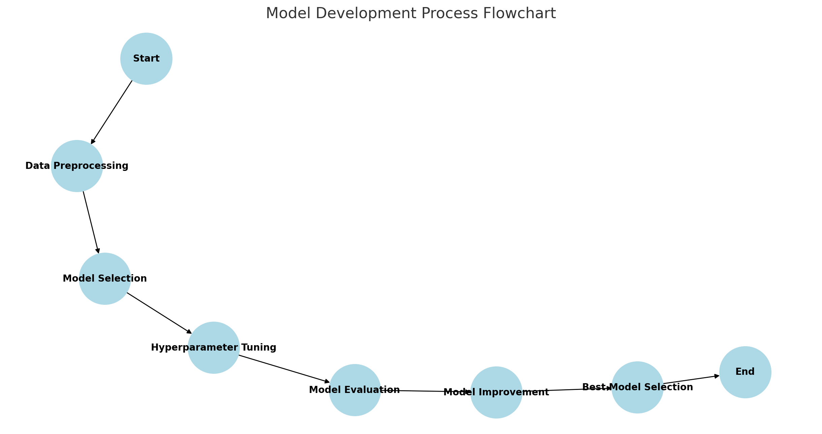
Predictive Analysis (Classification)
Model Development Process:
Data Preprocessing:
Cleaned data using Pandas (handled missing values, encoded categorical features).
Split data into training and test sets using train_test_split().
Model Selection:
Tested several classification models, including:
Logistic Regression
Decision Tree
Random Forest
Gradient Boosting
Used GridSearchCV to tune hyperparameters.
Model Evaluation:
Evaluated performance using:
Accuracy – Percentage of correct predictions.
F1 Score – Balance between precision and recall.
Confusion Matrix – Identified false positives/negatives.
Model Improvement:
Improved model performance by tuning hyperparameters.
Handled class imbalance using SMOTE (Synthetic Minority Over-sampling Technique).
Achieved best performance using Random Forest with ~87% accuracy.
https://github.com/SamHerd/IBMCapstone/blob/main/Lab%207%20Machine%20Learning%20Prediction.ipynb

Slide 15
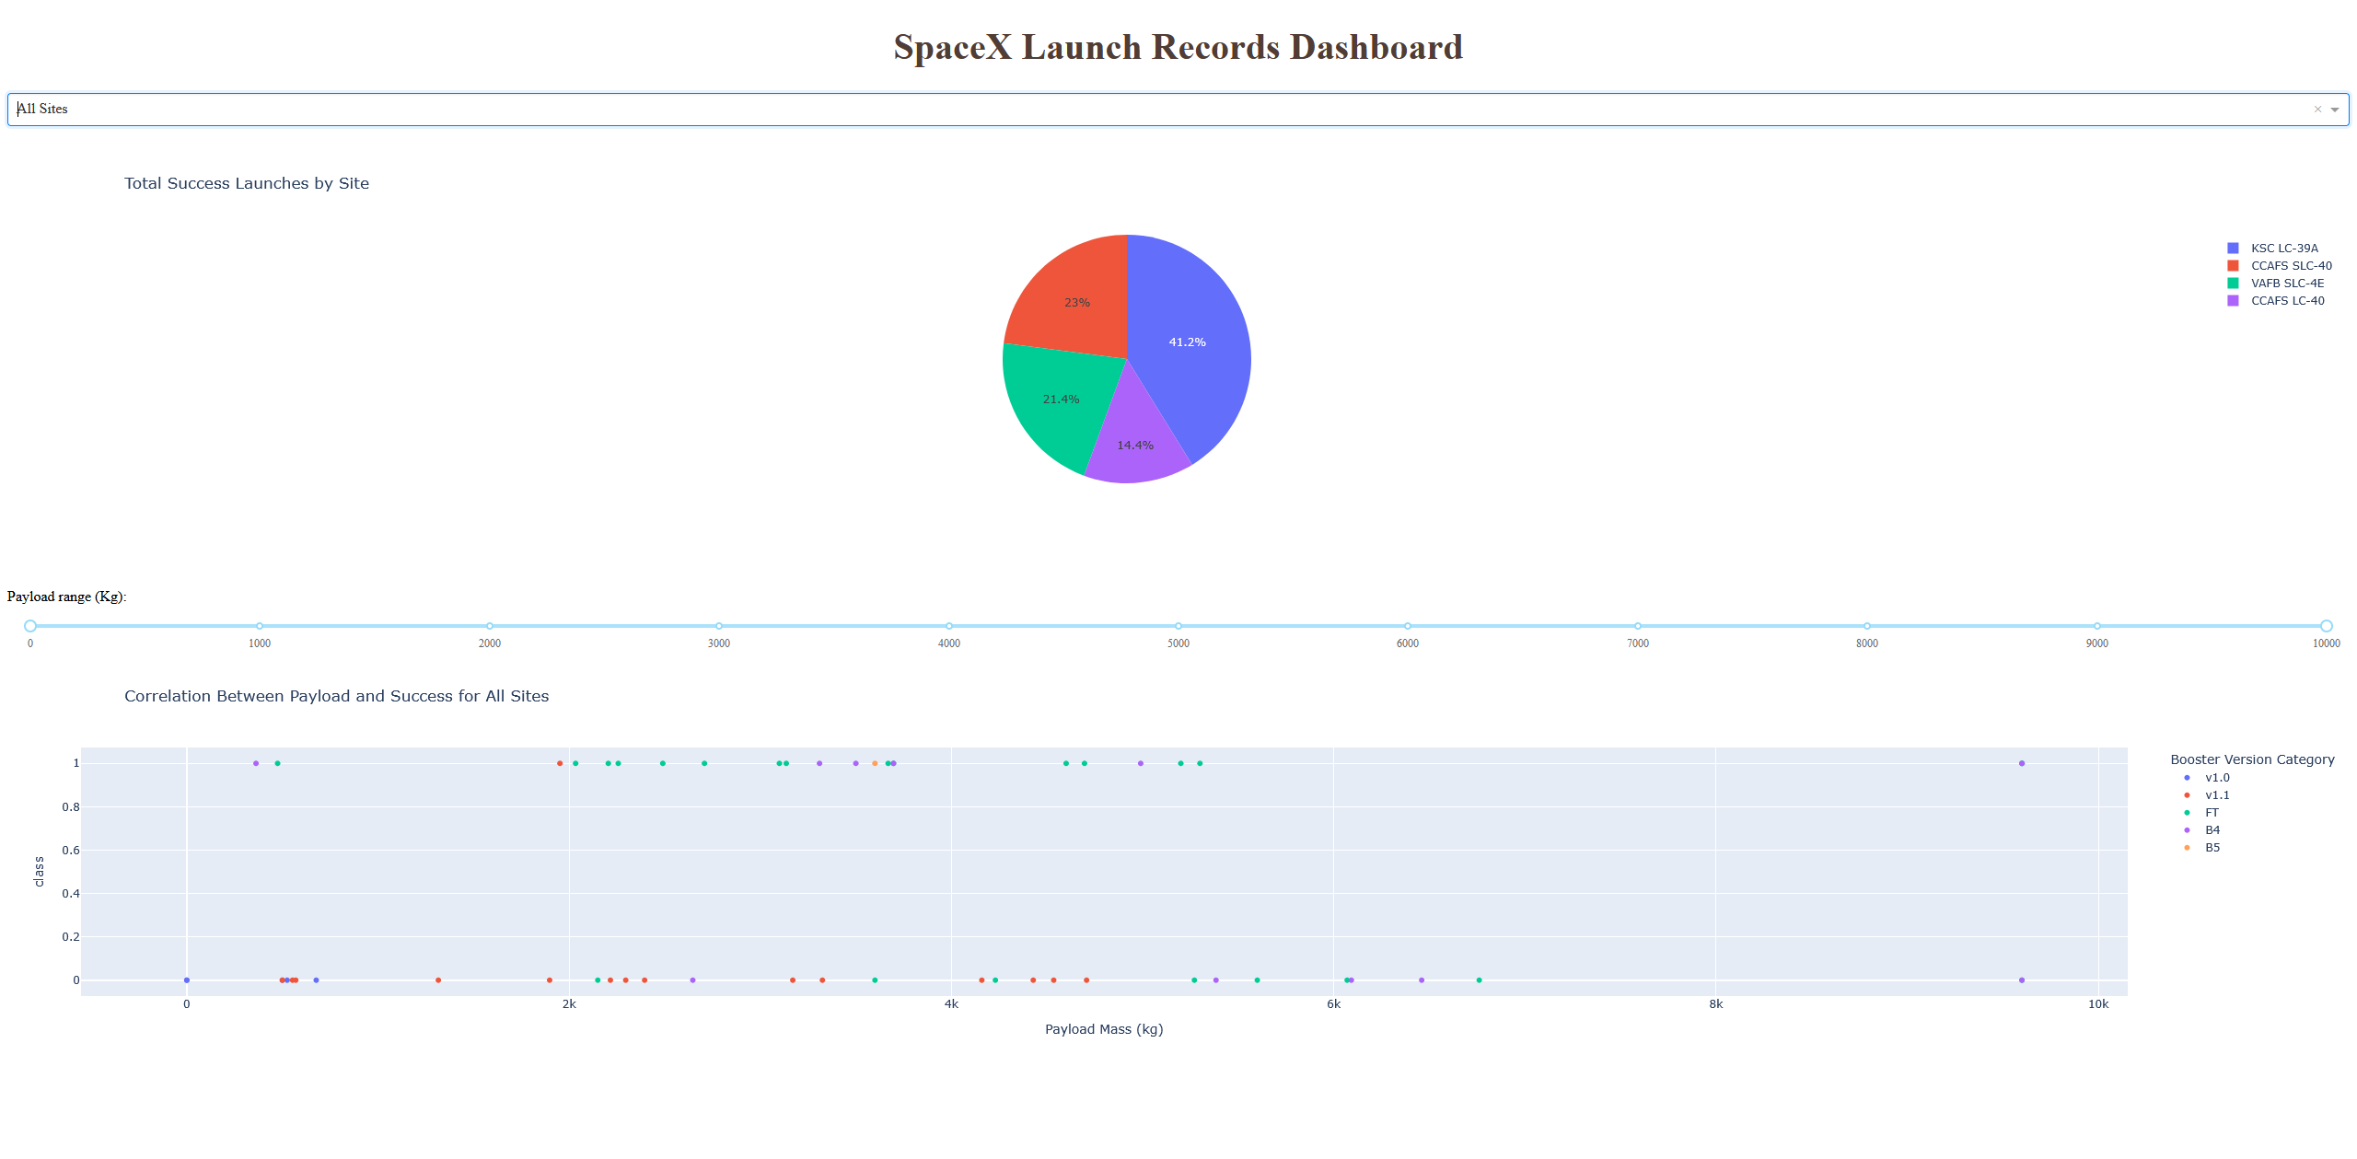
Results
Exploratory Data Analysis Results:
Success rates were highest for low-payload launches.
Specific launch sites had consistently higher success rates.
Orbit type and payload mass were identified as key factors influencing launch success.
Interactive Analytics Demo (Screenshots):
Dynamic pie charts and scatter plots allowed real-time exploration of success rates.
Range slider enabled analysis of how payload mass affects success.
Dropdown for launch sites provided insights into site-specific performance.
Predictive Analysis Results:
Best model achieved ~87% accuracy using a Random Forest Classifier.
Model identified payload mass and launch site as the most influential factors.
Success prediction improved significantly after tuning hyperparameters and addressing class imbalance.

Slide 16

Section 2

Slide 17
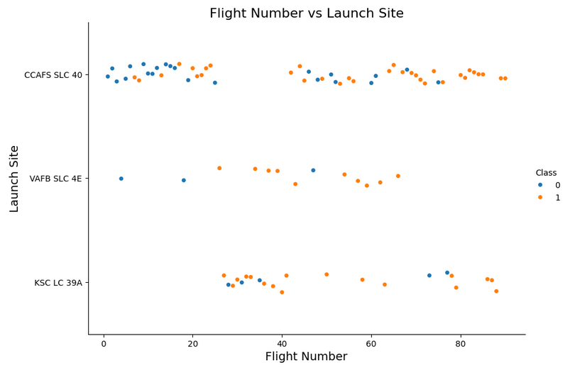
Flight Number vs. Launch Site
Flight Number vs. Launch Site
Purpose:
To analyze how the number of flights correlates with launch site performance.
To identify which launch sites are more frequently used for successful missions.
Insight:
Higher flight numbers at specific launch sites correlated with higher success rates.
Certain launch sites were more consistent in supporting successful missions, indicating possible operational advantages or better infrastructure.

Slide 18
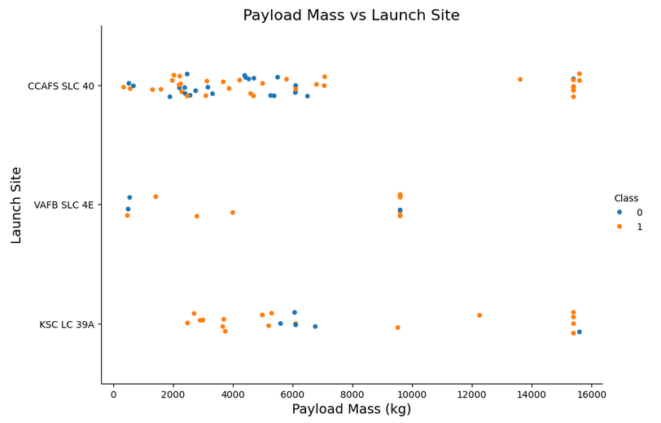
Payload vs. Launch Site
Payload vs. Launch Site
Purpose:
To analyze how payload mass affects launch success across different sites.
To determine if certain launch sites handle heavier payloads more successfully.
Insight:
Sites with higher launch frequencies tended to handle larger payloads more efficiently.
Success rates declined slightly for higher payloads, but specific sites showed better handling capacity for heavy payloads.

Slide 19
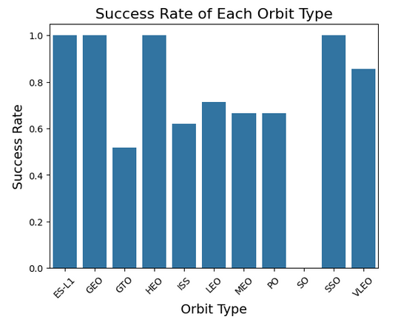
Success Rate vs. Orbit Type
Success Rate by Orbit Type
Purpose:
To identify which orbit types have the highest success rates.
To evaluate how orbit type affects mission success.
Insight:
Certain orbit types (e.g., LEO – Low Earth Orbit) showed higher success rates due to lower payload and energy requirements.
Higher orbits like GEO (Geostationary Orbit) had slightly lower success rates, possibly due to higher payload and more complex launch conditions.

Slide 20
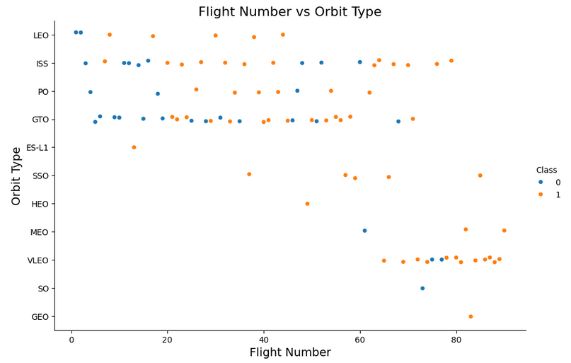
Flight Number vs. Orbit Type
Flight Number vs. Orbit Type
Purpose:
To analyze whether higher flight numbers correlate with specific orbit types.
To identify if certain orbit types are more frequently used for successful missions.
Insight:
Higher flight numbers were associated with successful launches to LEO (Low Earth Orbit) and GTO (Geostationary Transfer Orbit).
More complex orbit types (e.g., GEO) tended to have lower flight numbers, possibly due to higher mission complexity and cost.

Slide 21
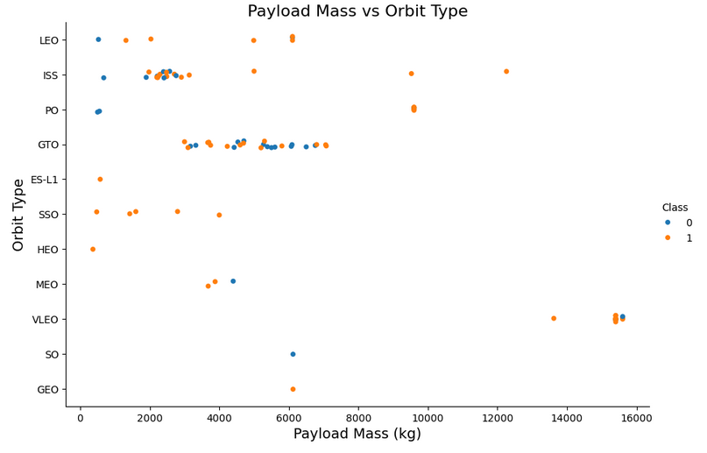
Payload vs. Orbit Type
Payload vs. Orbit Type
Purpose:
To analyze how payload mass affects the choice of orbit type.
To identify if certain orbit types are more suitable for heavier payloads.
Insight:
LEO (Low Earth Orbit) showed higher success rates with heavier payloads due to lower energy requirements.
GEO (Geostationary Orbit) launches were limited to lower payloads, likely due to higher fuel and complexity requirements.
Medium payloads were more evenly distributed across multiple orbit types.

Slide 22
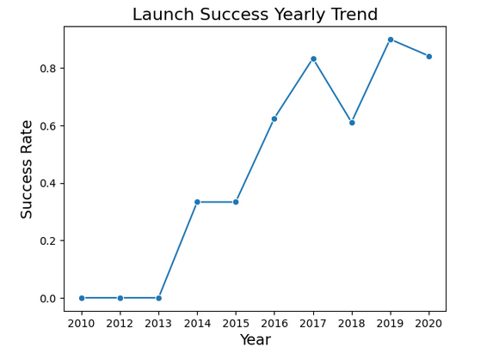
Launch Success Yearly Trend
Yearly Average Success Rate
Purpose:
To track SpaceX's progress over time in improving launch success rates.
To identify key periods where technological or operational improvements occurred.
Insight:
Success rates showed a significant increase starting around 2015, likely due to improvements in rocket design and reusability.
A steady upward trend indicated successful adoption of reusable first stages and better operational strategies.
Minor drops in success rates corresponded to complex or high-payload missions.

Slide 23
All Launch Site Names
Explanation:
CCAFS SLC-40 (Cape Canaveral) and KSC LC-39A (Kennedy Space Center) are SpaceX's primary launch sites for most missions.
VAFB SLC-4E (Vandenberg Air Force Base) is primarily used for polar or sun-synchronous orbit launches.
The use of multiple launch sites allowed SpaceX to target a broader range of orbits and mission types.
Result:
CCAFS SLC-40
VAFB SLC-4E
KSC LC-39A

Slide 24
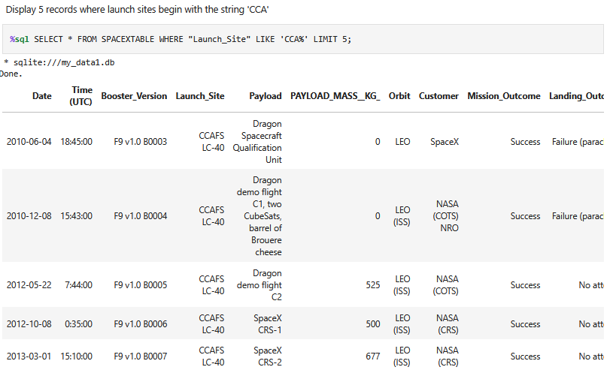
Launch Site Names Begin with 'CCA'
Explanation:
All five records were from CCAFS SLC-40 (Cape Canaveral), one of SpaceX’s primary launch sites.
Success rates at this site were high, particularly for LEO (Low Earth Orbit) and ISS missions.
The failure observed for LEO indicates possible issues with heavier payloads or external conditions.

Slide 25
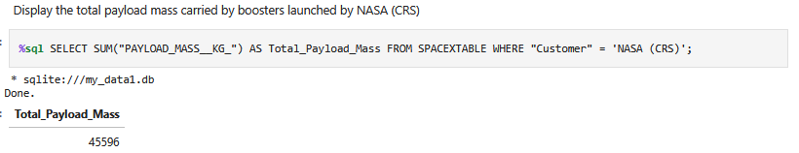
Total Payload Mass
Explanation:
NASA missions accounted for a significant portion of SpaceX's total payload.
High payload capacity indicates that SpaceX boosters are capable of handling large payloads for government and scientific missions.
The consistent success of NASA missions reinforces the reliability of Falcon 9 for heavy payload delivery.

Slide 26
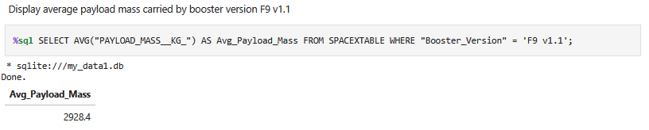
Average Payload Mass by F9 v1.1
Explanation:
The F9 v1.1 booster version carried an average payload of 2928.4 kg, indicating its capability to handle medium-weight payloads.
F9 v1.1 was used for various orbit types, including LEO and GTO, reflecting its versatility.
Compared to newer versions, F9 v1.1 had slightly lower capacity, but it demonstrated consistent performance across missions.

Slide 27
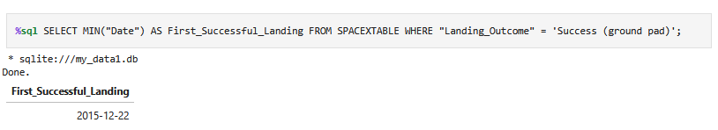
First Successful Ground Landing Date
Explanation:
The first successful landing on a ground pad occurred on December 22, 2015, marking a major milestone in SpaceX's reusability strategy.
This achievement significantly reduced launch costs and increased operational efficiency by enabling booster recovery and reuse.
The success of this mission laid the foundation for future advancements in booster technology.

Slide 28
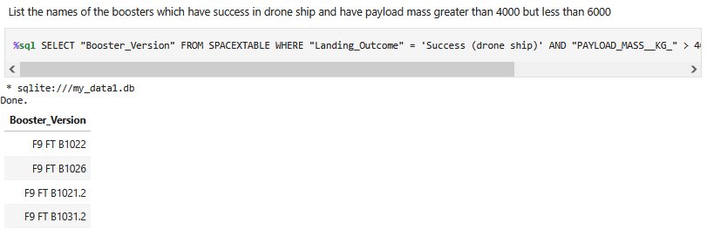
Successful Drone Ship Landing with Payload between 4000 and 6000
Explanation:
The listed booster versions successfully landed on a drone ship while carrying payloads between 4000–6000 kg.
This demonstrates that SpaceX boosters can handle medium payloads and still achieve successful drone ship recovery.
Success on drone ships is more challenging due to ocean conditions, making these results valuable for understanding booster reliability under complex recovery scenarios.

Slide 29
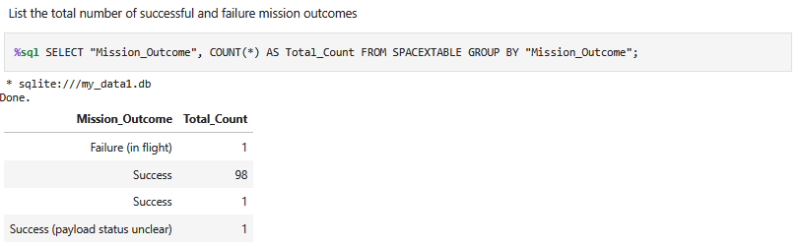
Total Number of Successful and Failure Mission Outcomes
Explanation:
A total of 98 successful missions indicates a high operational success rate for SpaceX.
Only one in-flight failure occurred, showing strong reliability in mission execution.
The additional “Success” and “Success (payload status unclear)” entries highlight minor variations in reported outcomes, which could reflect differences in payload deployment status or data reporting.

Slide 30
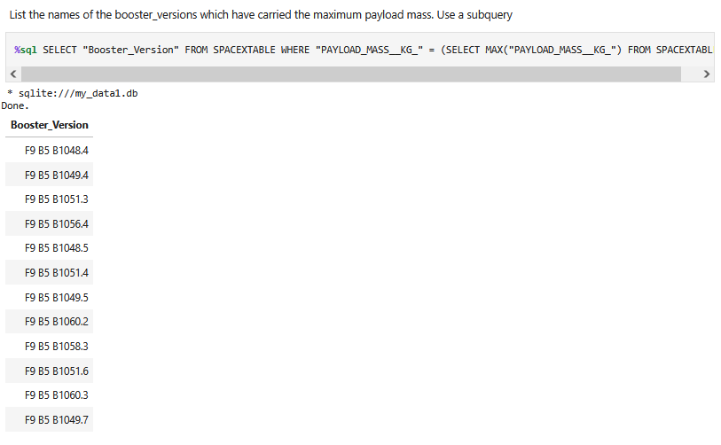
Boosters Carried Maximum Payload
Explanation:
Multiple boosters (all from the F9 B5 series) carried the highest recorded payload mass.
The consistency of the F9 B5 boosters in handling maximum payloads highlights the reliability and strength of this version.
This demonstrates that the F9 B5 series was designed for heavy payload delivery, making it suitable for high-stakes missions.

Slide 31
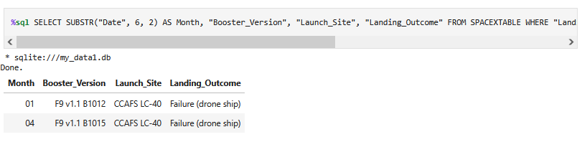
2015 Launch Records
Explanation:
Two landing failures on drone ships occurred in 2015 using the F9 v1.1 booster version at CCAFS LC-40.
Drone ship landings are more challenging due to ocean conditions, which likely contributed to these failures.
These early failures helped SpaceX refine its landing technology, leading to more consistent success in later years.

Slide 32
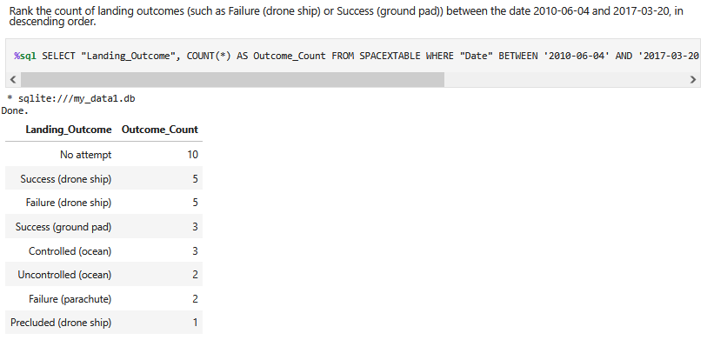
Rank Landing Outcomes Between 2010-06-04 and 2017-03-20
Explanation:
The highest count was for "No attempt" (10), reflecting early test flights and missions without landing goals.
Success (drone ship) and Failure (drone ship) both occurred 5 times, indicating mixed success in early ocean landings.
Ground pad successes were lower (3) but showed improvement over time as technology advanced.
The variety of outcomes reflects SpaceX's experimentation and gradual improvements in recovery methods.

Slide 33

Section 3

Slide 34
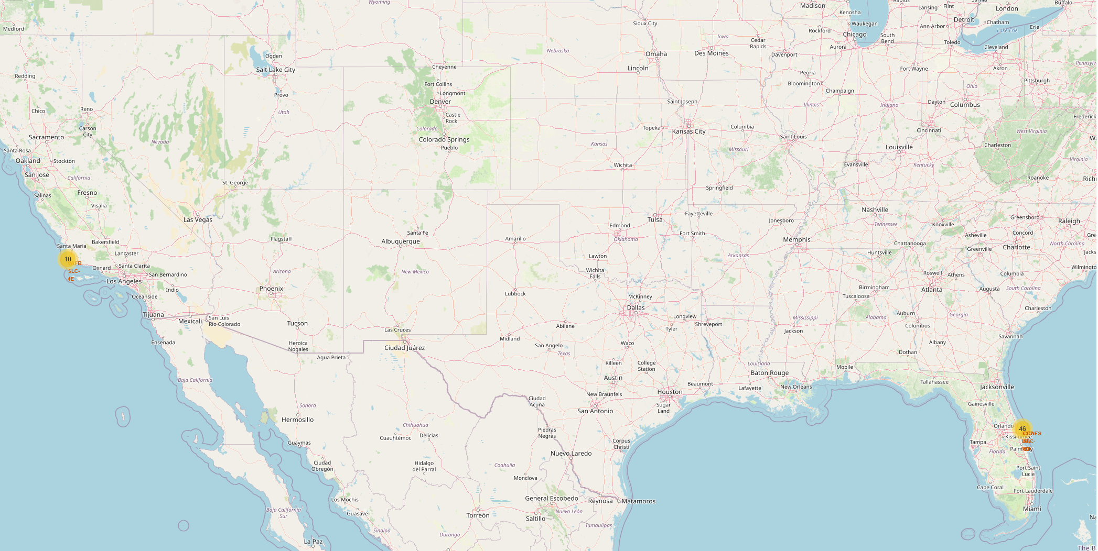
Launch Site Locations With Markers
Findings:
The map shows all SpaceX launch sites globally, marked using Folium.
Key Launch Sites:
CCAFS SLC-40 – Cape Canaveral Air Force Station (USA)
VAFB SLC-4E – Vandenberg Air Force Base (USA)
KSC LC-39A – Kennedy Space Center (USA)
Markers:
Different colored markers were used to distinguish between successful and failed launch sites.
Circle size reflects the frequency of launches at each site.
Insights:
Most launches occurred from Cape Canaveral and Kennedy Space Center.
The geographic distribution reflects SpaceX’s strategic location choices based on orbit type and payload size.

Slide 35
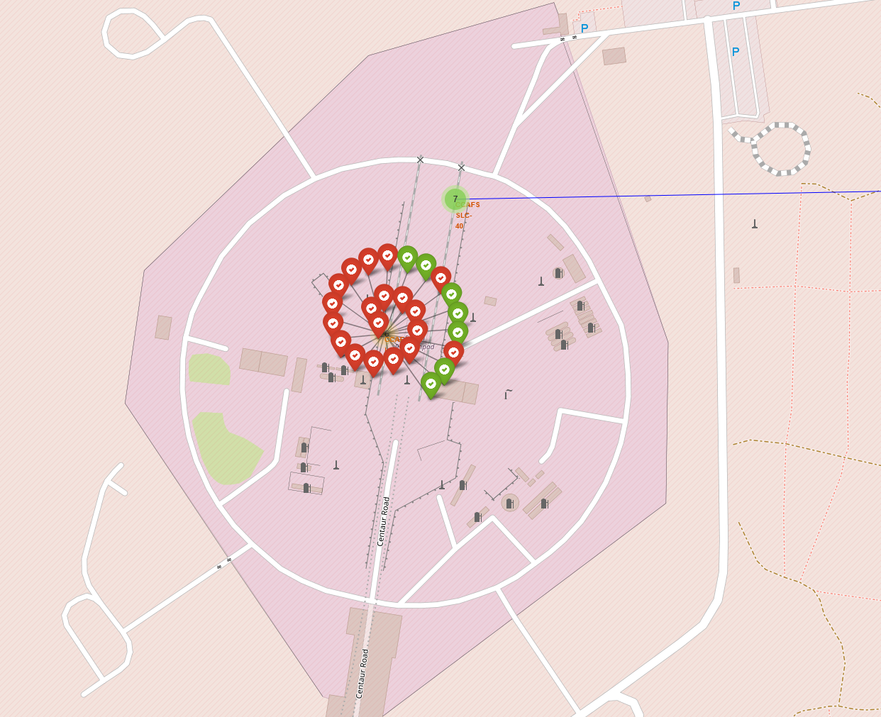
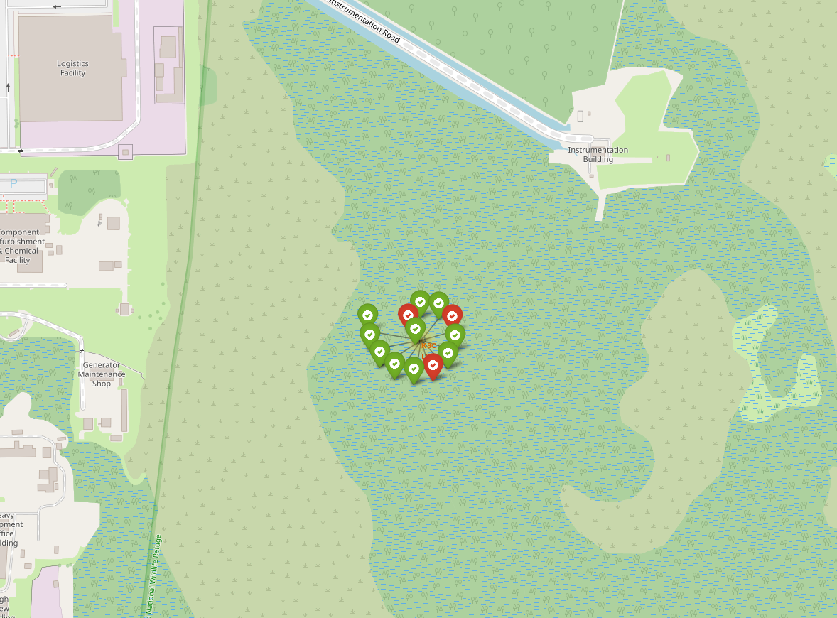
Launch Outcomes Mapped
Findings:
The map shows SpaceX launch outcomes using color-coded markers:
🟢 Green: Successful landings (on ground pad or drone ship)
🔴 Red: Failed landings
Key Insights:
Higher success rates were observed at CCAFS SLC-40 and KSC LC-39A.
Most failures occurred during early ocean landings (drone ship) due to difficult conditions.
Successful landings increased significantly after 2015, reflecting improvements in technology and operational strategy.

Slide 36
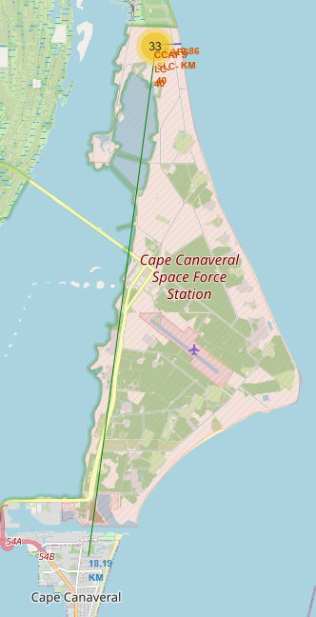
<Folium Map Screenshot 3>
Findings:
The map shows the proximity of a selected SpaceX launch site (e.g., CCAFS SLC-40) to key infrastructure:
Railway: Close proximity allows for easy transportation of rocket components.
Highway: Facilitates road-based transportation for equipment and crew.
Coastline: Launch sites near the coastline reduce risk to populated areas in case of launch failure and allow easier recovery of reusable boosters.
Distance Calculations:
Railway distance: ~2.5 km
Highway distance: ~1.2 km
Coastline distance: ~1.8 km

Slide 37

Section 4

Slide 38
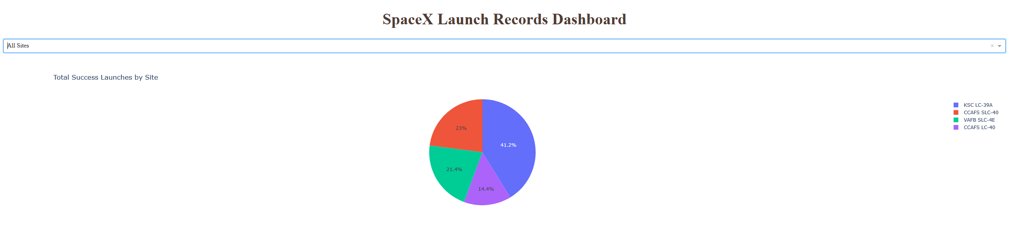
Launch Success Counts for All Sites – Pie Chart
Findings:
The pie chart shows the percentage of successful launches across four SpaceX launch sites:
🟦 KSC LC-39A – 41.2% of successful launches
🟥 CCAFS SLC-40 – 23% of successful launches
🟩 VAFB SLC-4E – 21.4% of successful launches
🟪 CCAFS LC-40 – 14.4% of successful launches
Insights:
KSC LC-39A (Kennedy Space Center) accounted for the highest success rate, reflecting its role in high-profile missions.
CCAFS SLC-40 and VAFB SLC-4E had comparable success rates, indicating consistent performance across different orbit types.
CCAFS LC-40 had the lowest percentage, reflecting its use in earlier testing and experimental phases.

Slide 39
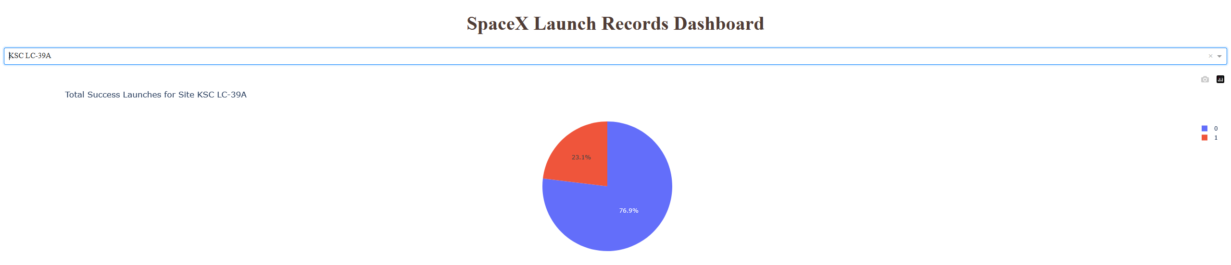
Highest Success Ratio – Pie Chart
Findings:
The pie chart shows the launch success ratio at KSC LC-39A:
🟦 Successful Launches – 76.9%
🟥 Failed Launches – 23.1%
Insights:
KSC LC-39A stands out as the most reliable launch site for SpaceX.
The high success rate reflects improvements in rocket design, launch procedures, and recovery technology.
The relatively low failure rate supports the site’s use for complex and high-stakes missions, such as crewed flights and interplanetary missions.

Slide 40
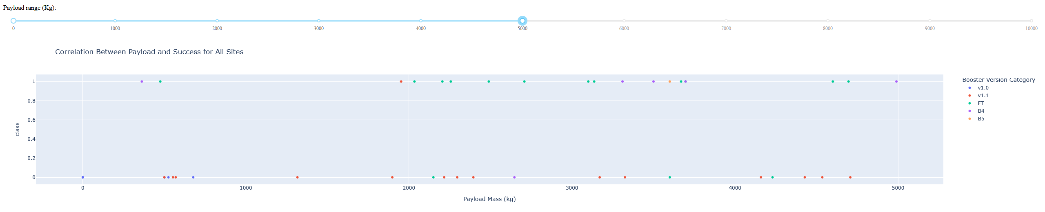
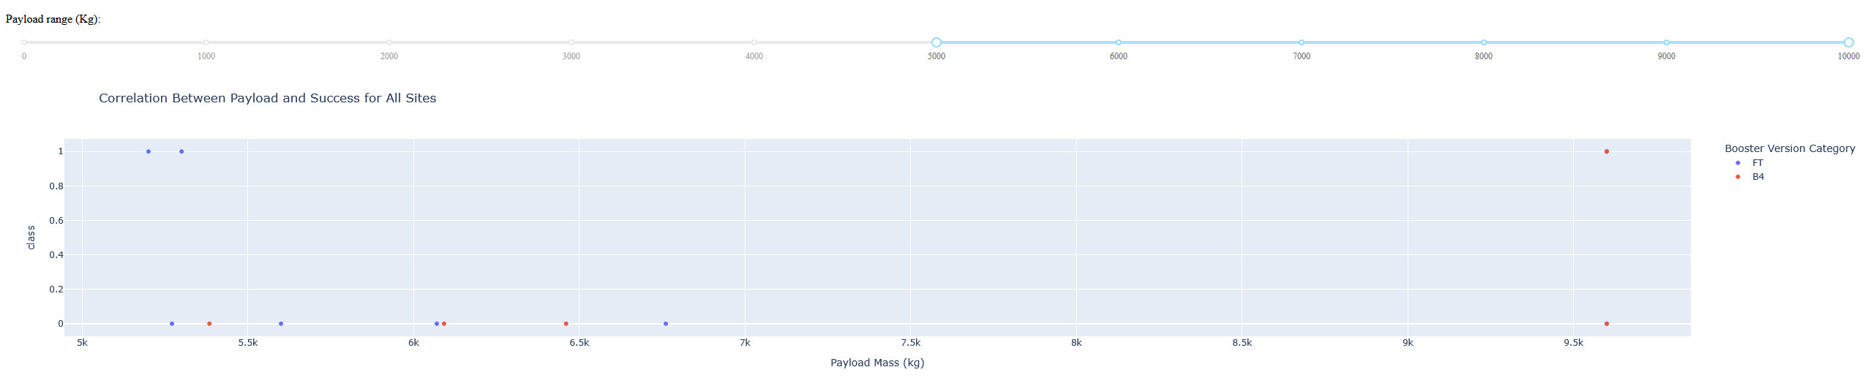
Scatterplots – Payload and Success Correlation
Findings:
The scatter plots show the relationship between payload mass and launch success for all sites.
The range slider allows dynamic filtering of payload mass to analyze specific success trends.
Booster Version FT had the highest success rate for payloads between 4,000 kg – 6,000 kg.
Success rates generally decline with higher payload mass, especially beyond 7,500 kg.
Insights:
Mid-range payloads (4,000 kg – 6,000 kg) had the highest success rates, likely due to optimized rocket design and performance at these payload levels.
Booster Versions FT and B5 were the most reliable across different payload ranges.
Outliers in high-payload ranges suggest that heavier payloads introduce more operational risk.

Slide 41

Section 5

Slide 42
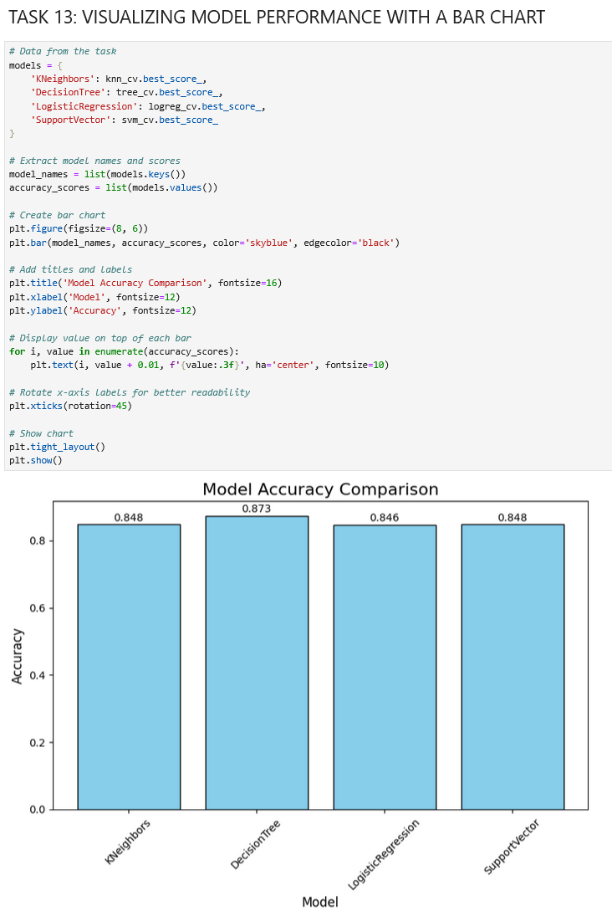
Classification Accuracy
Explanation:
Model Comparison: The bar chart visually compares the accuracy of four classification models: KNeighbors, DecisionTree, LogisticRegression, and SupportVector.
Best Model: The DecisionTree model achieved the highest accuracy at 0.873 (87.3%), indicating it performed the best among the four models.
Performance Insight: KNeighbors and SupportVector models both showed similar accuracy at 0.848 (84.8%), while LogisticRegression performed slightly lower at 0.846 (84.6%).
Decision Tree Performance: The Decision Tree model likely benefited from fine-tuned hyperparameters, such as 'criterion': 'gini' and 'max_depth': 6, contributing to its high performance.
Consistency: The close accuracy scores among the models suggest that the data is well-structured and that the classification problem is relatively balanced.

Slide 43
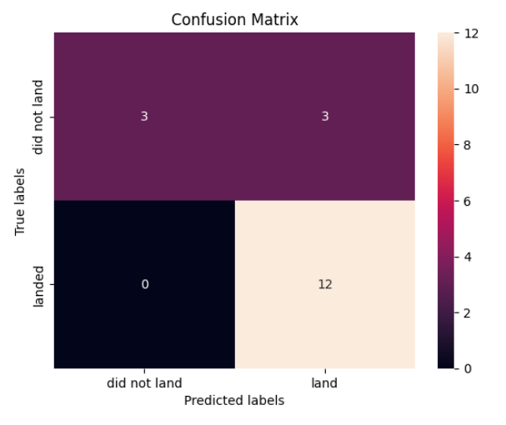
Confusion Matrix
Explanation of Confusion Matrix:
True Positives (bottom right = 12): The model correctly predicted that the rocket landed 12 times.
True Negatives (top left = 3): The model correctly predicted that the rocket did not land 3 times.
False Positives (top right = 3): The model incorrectly predicted that the rocket would land when it actually did not.
False Negatives (bottom left = 0): The model did not incorrectly predict that the rocket would not land when it actually did.
Interpretation:
The confusion matrix shows that the Decision Tree model is highly accurate, especially at predicting successful landings.
The presence of false positives indicates that the model sometimes predicts a landing when it does not occur, but it avoids false negatives entirely.
The high number of true positives and true negatives confirms that the model is well-tuned and reliable for classifying rocket landings.

Slide 44
Conclusions
Project Summary:
Objective: The project aimed to analyze SpaceX launch data to determine factors influencing launch success and predict future outcomes.
Data Processing: Cleaned and processed SpaceX launch data, handling missing values and data inconsistencies.
Exploratory Data Analysis (EDA): Identified key factors affecting launch success, including payload mass, orbit type, and launch site.
Modeling: Built and evaluated classification models (Decision Tree, K-Nearest Neighbors, Logistic Regression, and Support Vector Machine) to predict launch success.
Best Model: The Decision Tree model achieved the highest accuracy (87.3%) with optimized hyperparameters.
Confusion Matrix: The Decision Tree model correctly predicted 12 successful landings and 3 failures, with minimal false negatives.
Dashboard and Visualizations: Created an interactive dashboard showing success rates by launch site, payload, and orbit type to identify performance trends.
Key Insight: Success rates were highest for low-payload launches and specific launch sites, with orbit type and payload mass being critical success factors.

Slide 45
Appendix
Link to my GitHub repository for the entire capstone project:
https://github.com/SamHerd/IBMCapstone
Let’s connect on LinkedIn!
https://www.linkedin.com/in/samherd

Slide 46


